Slide 1
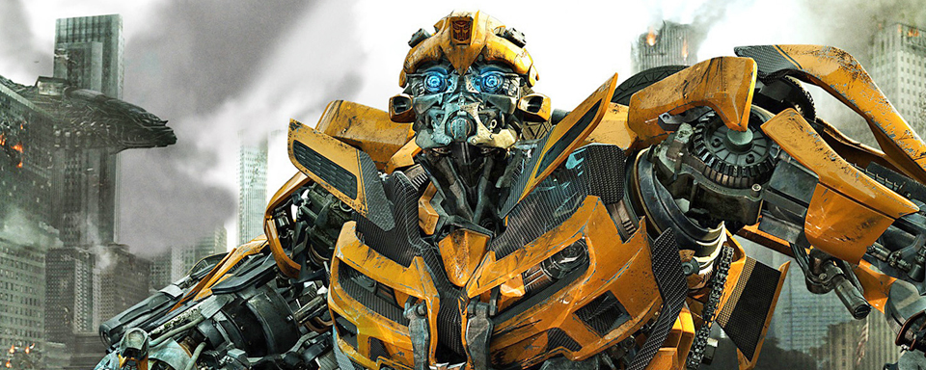

Transfer and Multitask Learning for Aspect-Based Sentiment Analysis Using the Google Transformer Architecture
Felix Schober
09.05.2019
Introduction
Departement of Informatics
Notes:
https://io9.gizmodo.com/it-sounds-like-even-the-bumblebee-spinoff-movie-wont-fo-1795705980

Slide 2
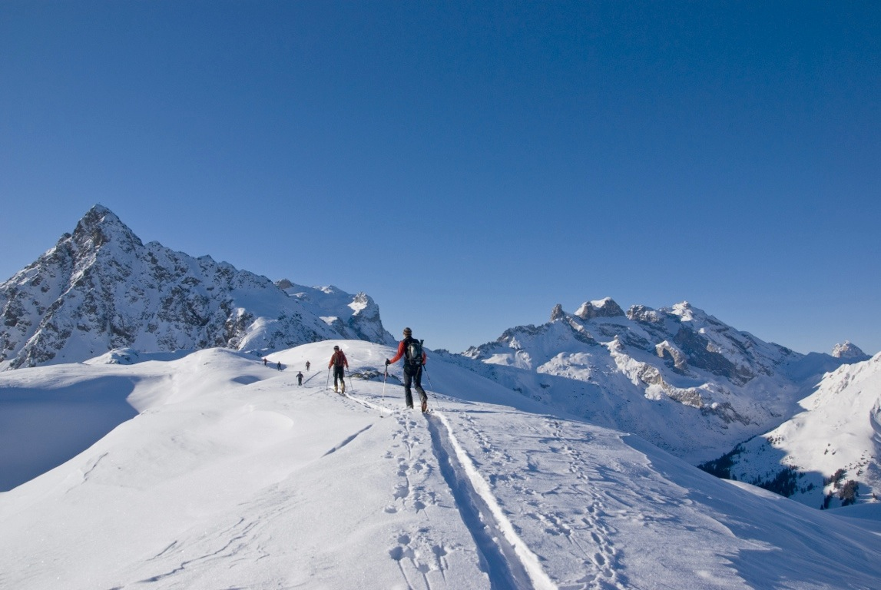

Agenda
Introduction: ABSA & Transformer
Useful Information: Docker & Hyperparameters
Discussion of Results
Multitask & Transfer Learning
Conclusion

Slide 3
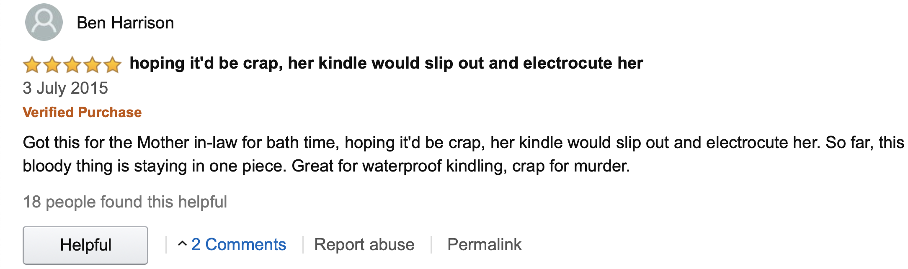
Aspect Based Sentiment
[1]
Aspect Waterproofing: Positive
Aspect Murder: Negative

Slide 4



Google Transformer
[2]
Encoder $n$
Decoder $n$
OUTPUT
?? ???? ??????
I Like ??????
Encoder …
Decoder …
Decoder $n$
OUTPUT
Decoder …
Encoder 2
Decoder 2
prev. OUTPUTS
Decoder 2
I Like
Decoder 1
EMBEDDING
Encoder 1
Decoder 1
EMBEDDING
EMBEDDING
Ich mag Flugzeuge
… … …
INPUT
prev. Outputs

Slide 5
Google Transformer
[2]
Encoder $n$
Decoder $n$
OUTPUT
?? ???? ??????
I Like ??????
Encoder …
Decoder …
Decoder $n$
OUTPUT
Decoder …
Encoder 2
Decoder 2
prev. OUTPUTS
Decoder 2
I Like
Decoder 1
EMBEDDING
Encoder 1
Decoder 1
EMBEDDING
EMBEDDING
Ich mag Flugzeuge
… … …
INPUT
prev. Outputs

Slide 6
Google Transformer
[2]
Encoder $n$
Decoder $n$
OUTPUT
?? ???? ??????
I Like ??????
Encoder …
Decoder …
Decoder $n$
OUTPUT
Decoder …
Encoder 2
Decoder 2
prev. OUTPUTS
Decoder 2
I Like
Decoder 1
EMBEDDING
Encoder 1
Decoder 1
EMBEDDING
EMBEDDING
Ich mag Flugzeuge
… … …
INPUT
prev. Outputs

Slide 7
Google Transformer
[2]
Encoder $n$
Decoder $n$
OUTPUT
?? ???? ??????
I Like ??????
Encoder …
Decoder …
Decoder $n$
OUTPUT
Decoder …
Encoder 2
Decoder 2
prev. OUTPUTS
Decoder 2
I Like
Decoder 1
EMBEDDING
Encoder 1
Decoder 1
EMBEDDING
EMBEDDING
Ich mag Flugzeuge
… … …
INPUT
prev. Outputs

Slide 8
Google Transformer
[2]
Encoder $n$
Decoder $n$
OUTPUT
?? ???? ??????
I Like ??????
Encoder …
Decoder …
Decoder $n$
OUTPUT
Decoder …
Encoder 2
Decoder 2
prev. OUTPUTS
Decoder 2
I Like
Decoder 1
EMBEDDING
Encoder 1
Decoder 1
EMBEDDING
EMBEDDING
Ich mag Flugzeuge
… … …
INPUT
prev. Outputs

Slide 9
Google Transformer
[2]
Encoder $n$
Decoder $n$
OUTPUT
?? ???? ??????
I Like ??????
Encoder …
Decoder …
Decoder $n$
OUTPUT
Decoder …
Encoder 2
Decoder 2
prev. OUTPUTS
Decoder 2
I Like
Decoder 1
EMBEDDING
Encoder 1
Decoder 1
EMBEDDING
EMBEDDING
Ich mag Flugzeuge
… … …
INPUT
prev. Outputs

Slide 10
Google Transformer
[2]
Encoder $n$
Decoder $n$
OUTPUT
?? ???? ??????
I Like ??????
Encoder …
Decoder …
Decoder $n$
OUTPUT
Decoder …
Encoder 2
Decoder 2
prev. OUTPUTS
Decoder 2
I Like
Decoder 1
EMBEDDING
Encoder 1
Decoder 1
EMBEDDING
EMBEDDING
Ich mag Flugzeuge
… … …
INPUT
prev. Outputs

Slide 11
Google Transformer
[2]
Encoder $n$
Decoder $n$
OUTPUT
?? ???? ??????
I Like ??????
Encoder …
Decoder …
Decoder $n$
OUTPUT
Decoder …
Encoder 2
Decoder 2
prev. OUTPUTS
Decoder 2
I Like
Decoder 1
EMBEDDING
Encoder 1
Decoder 1
EMBEDDING
EMBEDDING
Ich mag Flugzeuge
… … …
INPUT
prev. Outputs

Slide 12
Google Transformer
[2]
Encoder $n$
Decoder $n$
OUTPUT
?? ???? ??????
I Like ??????
Encoder …
Decoder …
Decoder $n$
OUTPUT
Decoder …
Encoder 2
Decoder 2
prev. OUTPUTS
Decoder 2
I Like
Decoder 1
EMBEDDING
Encoder 1
Decoder 1
EMBEDDING
EMBEDDING
Ich mag Flugzeuge
… … …
INPUT
prev. Outputs

Slide 13
Google Transformer
[2]
Encoder $n$
Decoder $n$
OUTPUT
I ???? ??????
I Like ??????
Encoder …
Decoder …
Decoder $n$
OUTPUT
Decoder …
Encoder 2
Decoder 2
prev. OUTPUTS
Decoder 2
I Like
Decoder 1
EMBEDDING
Encoder 1
Decoder 1
EMBEDDING
EMBEDDING
Ich mag Flugzeuge
… … …
INPUT
prev. Outputs

Slide 14
Google Transformer
[2]
Encoder $n$
Decoder $n$
OUTPUT
I ???? ??????
I Like ??????
Encoder …
Decoder …
Decoder $n$
OUTPUT
Decoder …
Encoder 2
Decoder 2
prev. OUTPUTS
Decoder 2
I Like
Decoder 1
EMBEDDING
Encoder 1
Decoder 1
EMBEDDING
EMBEDDING
Ich mag Flugzeuge
… … …
INPUT
prev. Outputs

Slide 15
Google Transformer
[2]
Encoder $n$
Decoder $n$
OUTPUT
I ???? ??????
I Like ??????
Encoder …
Decoder …
Decoder $n$
OUTPUT
Decoder …
Encoder 2
Decoder 2
prev. OUTPUTS
Decoder 2
I Like
Decoder 1
EMBEDDING
Encoder 1
Decoder 1
EMBEDDING
EMBEDDING
Ich mag Flugzeuge
I … …
INPUT
prev. Outputs

Slide 16
Google Transformer
[2]
Encoder $n$
Decoder $n$
OUTPUT
I ???? ??????
I Like ??????
Encoder …
Decoder …
Decoder $n$
OUTPUT
Decoder …
Encoder 2
Decoder 2
prev. OUTPUTS
Decoder 2
I Like
Decoder 1
EMBEDDING
Encoder 1
Decoder 1
EMBEDDING
EMBEDDING
Ich mag Flugzeuge
I … …
INPUT
prev. Outputs

Slide 17
Google Transformer
[2]
Encoder $n$
Decoder $n$
OUTPUT
I ???? ??????
I Like ??????
Encoder …
Decoder …
Decoder $n$
OUTPUT
Decoder …
Encoder 2
Decoder 2
prev. OUTPUTS
Decoder 2
I Like
Decoder 1
EMBEDDING
Encoder 1
Decoder 1
EMBEDDING
EMBEDDING
Ich mag Flugzeuge
I … …
INPUT
prev. Outputs

Slide 18
Google Transformer
[2]
Encoder $n$
Decoder $n$
OUTPUT
I like ??????
I Like ??????
Encoder …
Decoder …
Decoder $n$
OUTPUT
Decoder …
Encoder 2
Decoder 2
prev. OUTPUTS
Decoder 2
I Like
Decoder 1
EMBEDDING
Encoder 1
Decoder 1
EMBEDDING
EMBEDDING
Ich mag Flugzeuge
I … …
INPUT
prev. Outputs

Slide 19
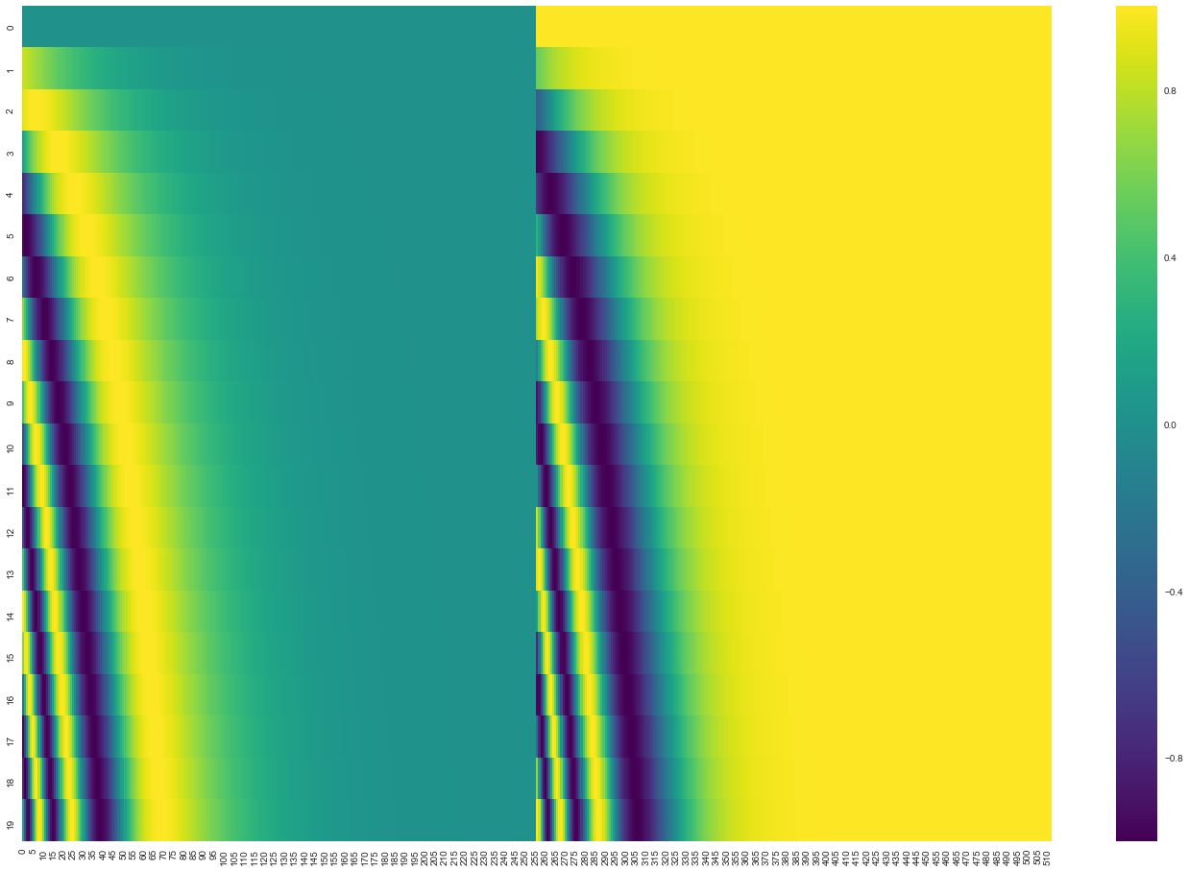

Google Transformer
ENCODER N_{x}
LAYER-NORM
DECODER N_{x}
LINEAR LAYER
LAYER-NORM
+
DROPOUT
SOFTMAX
+
POINTWISE
FEED FORWARD
DROPOUT
OUTPUT PROBABILITIES
LAYER-NORM
POINTWISE
FEED FORWARD
+
DROPOUT
MULTI-HEAD
ATTENTION
MULTI-HEAD
ATTENTION
MASKED
MULTI-HEAD
ATTENTION
LAYER-NORM
k
Q
V
k
Q
V
k
Q
V
+
DROPOUT
LAYER-NORM
+
MULTI-HEAD
ATTENTION
DROPOUT
MULTI-HEAD
ATTENTION
MULTI-HEAD
ATTENTION
MULTI-HEAD
ATTENTION
MULTI-HEAD
ATTENTION
MASKED
MULTI-HEAD
ATTENTION
k
Q
V
k
Q
V
k
Q
V
k
Q
V
k
Q
V
k
Q
V
POSITIONAL
ENCODING
+
+
POSITIONAL
ENCODING
EMBEDDING
EMBEDDING
[3]
INPUTS
PREV. OUTPUTS
5

Slide 20


ABSA-Transformer
ENCODER N_{x}
LAYER-NORM
ASPECT HEAD #1
ASPECT HEAD #2
ASPECT HEAD #3
+
DROPOUT
SOFTMAX
SOFTMAX
SOFTMAX
POINTWISE
FEED FORWARD
| N/A | POS | NEU | NEG |
1 0 0 0
| N/A | POS | NEU | NEG |
0 1 0 0
| N/A | POS | NEU | NEG |
1 0 0 0
HEALTHINESS
QUALITY
PRICE
LAYER-NORM
+
One Sentiment Head per Aspect
DROPOUT
MULTI-HEAD
ATTENTION
[69]
MULTI-HEAD
ATTENTION
MULTI-HEAD
ATTENTION
k
Q
V
k
Q
V
k
Q
V
POSITIONAL
ENCODING
+
EMBEDDING
INPUTS
6

Slide 21
Agenda
Introduction: ABSA & Transformer
Useful Information: Docker & Hyperparameters
Discussion of Results
Multitask & Transfer Learning
Conclusion

Slide 22







Docker
Docker
Virtual Machines
VM 1
VM 2
APP A
APP B
APP B
APP C
APP D
APP A
APP E
GUEST OPERATING SYSTEM
GUEST OPERATING SYSTEM
DOCKER
HYPERVISOR
HOST OPERATING SYSTEM
HOST OPERATING SYSTEM
HARDWARE / INFRASTRUCTURE
HARDWARE / INFRASTRUCTURE
8

Slide 23
Docker
Docker
APP B
APP C
APP D
APP A
APP E
Execution Time in s
DOCKER
HOST OPERATING SYSTEM
HARDWARE / INFRASTRUCTURE
9

Slide 24
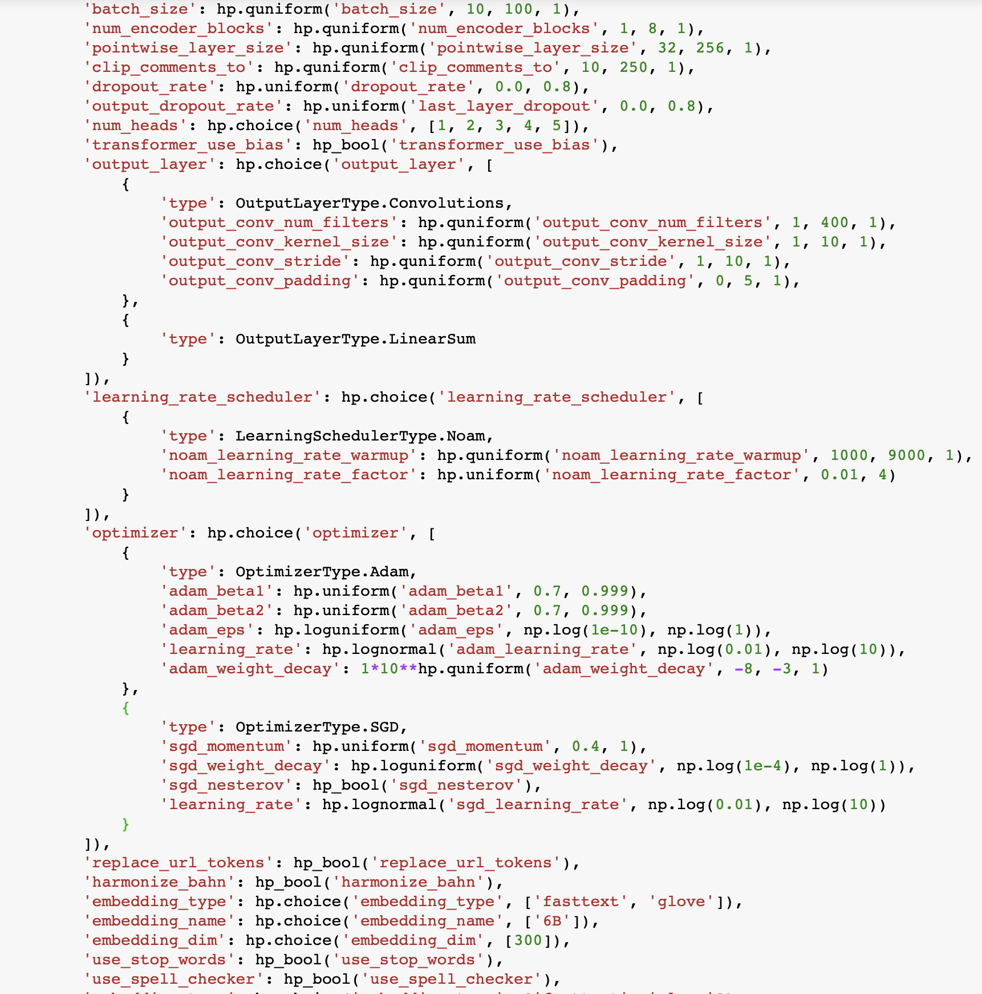
Hyper Parameter Optimization
Everything could be a Hyper Parameter:
Batch Size
Learning Rate
Optimizer
Model Architecture
Preprocessing
Hyperopt samples from a Search Space, so that parameters are chosen that reduce the model loss.
10

Slide 25
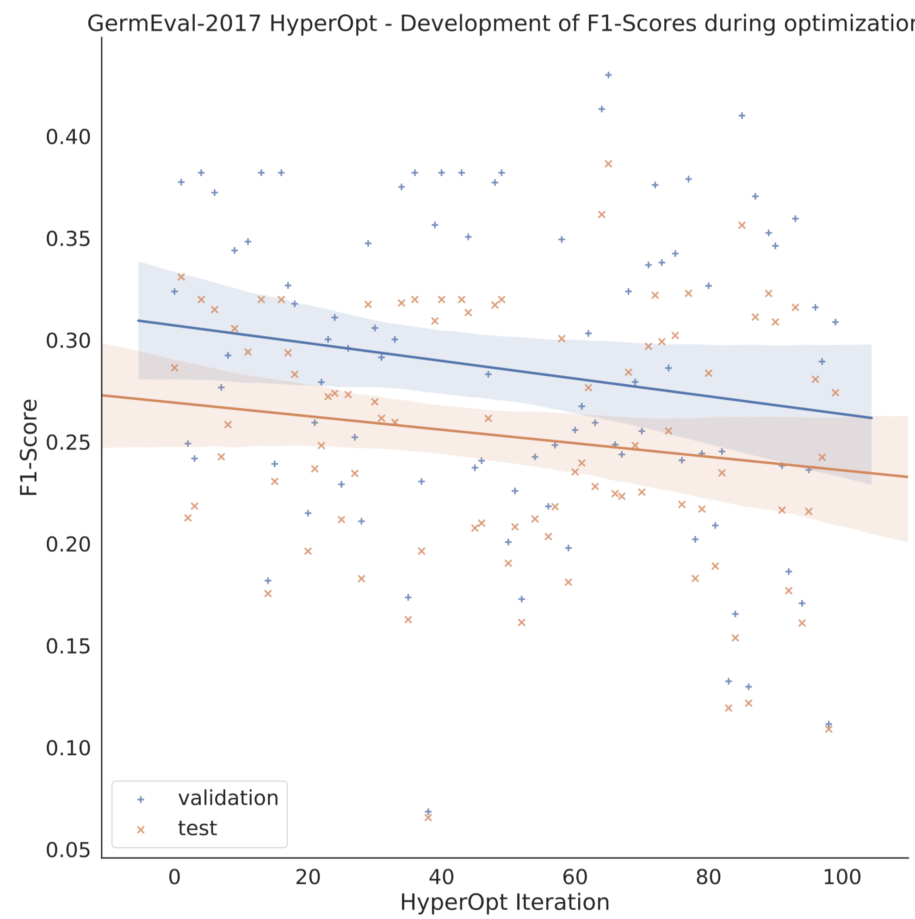
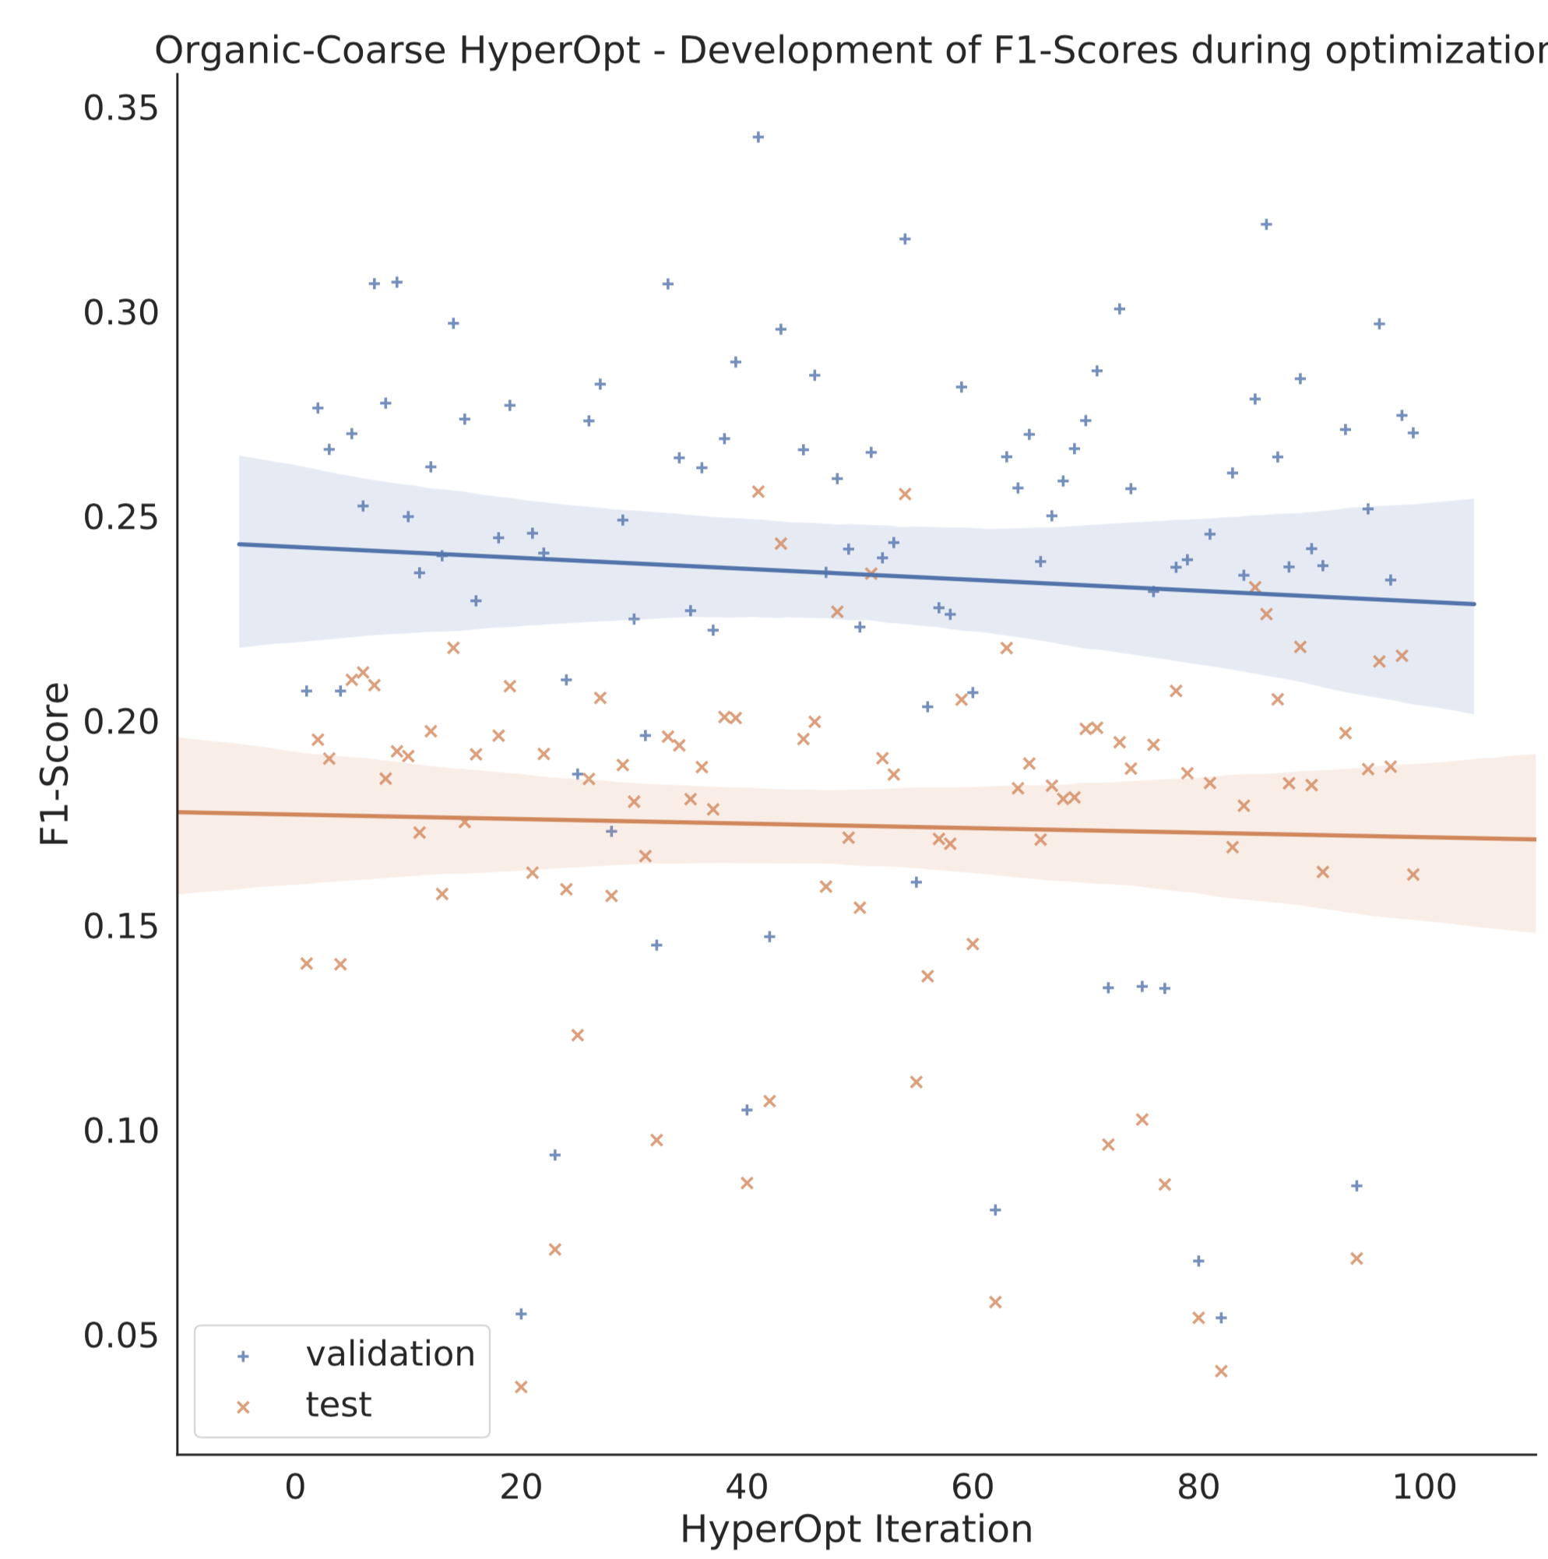
Hyper Parameter Optimization
11

Slide 26
Agenda
Introduction: ABSA & Transformer
Useful Information: Docker & Hyperparameters
Discussion of Results
Multitask & Transfer Learning
Conclusion

Slide 27
GermEval-2017
[84]
. @db_bahn F HBf, Nordeingang; http://t.co/dmXoHnYnNO
Ruhig, sonnig und zentrumsnah: grosses Doppelhaus mit Garten, 8620 Wetzikon ZH Hell und grossz√ºgig, ruhig und sonnig: Das sind die hervorstechendsten Eigenschaften, die dieses Doppeleinfamilienhaus mit Garten auszeichnen. Und alles, was die Familie im Alltag braucht, liegt leicht erreichbar nah: S-Bahn, L√§den und Schulen; der K
Allgemein - Neutral
Zugfahrt - Positiv
13

Slide 28
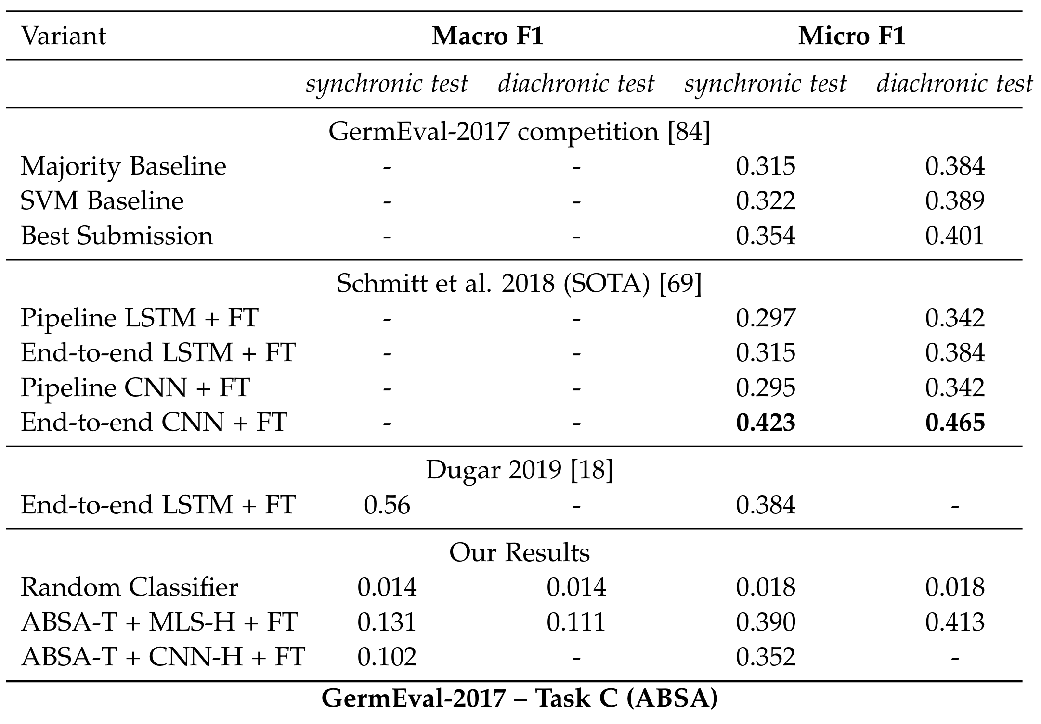
GermEval-2017 - Results
14

Slide 29
GermEval-2017 - Results
Micro F1 Score on the Synchronic Test Set – GermEval-2017 Evaluation Script
GermEval-2017
Schmitt et al.
Dugar
ABSA-T
15

Slide 30
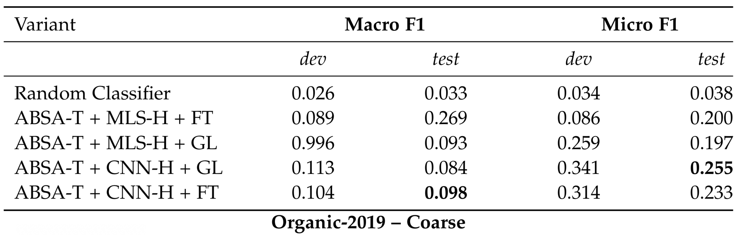
Organic-Coarse - Results
16

Slide 31
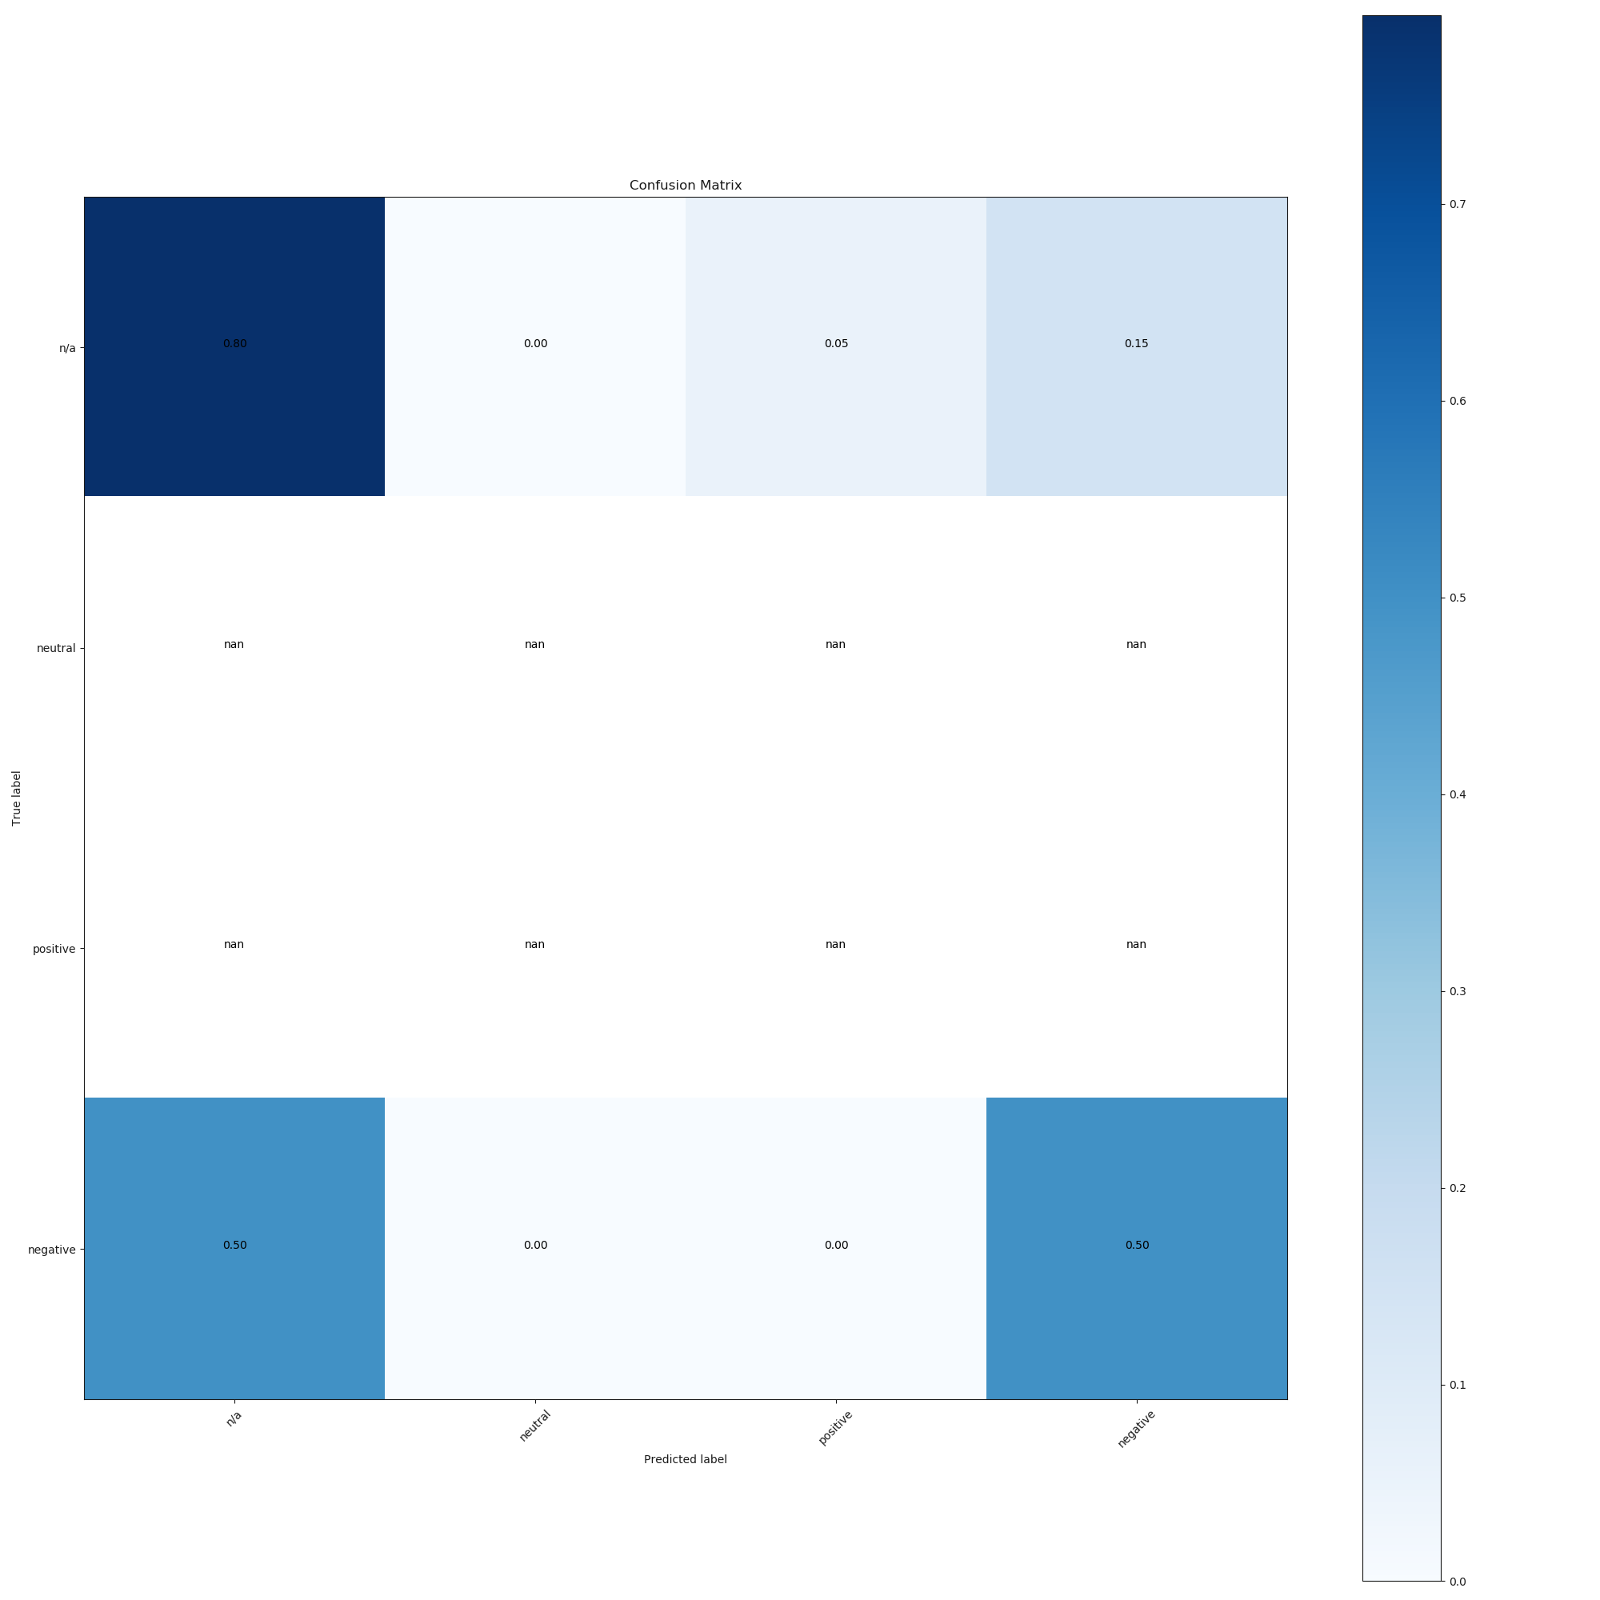
Organic-Coarse - Results
Conventional - Environment
n/a
0.8
0.0
0.05
0.15
neutral
negative
0.5
0.5
positive
n/a
neutral
positive
negative
17

Slide 32
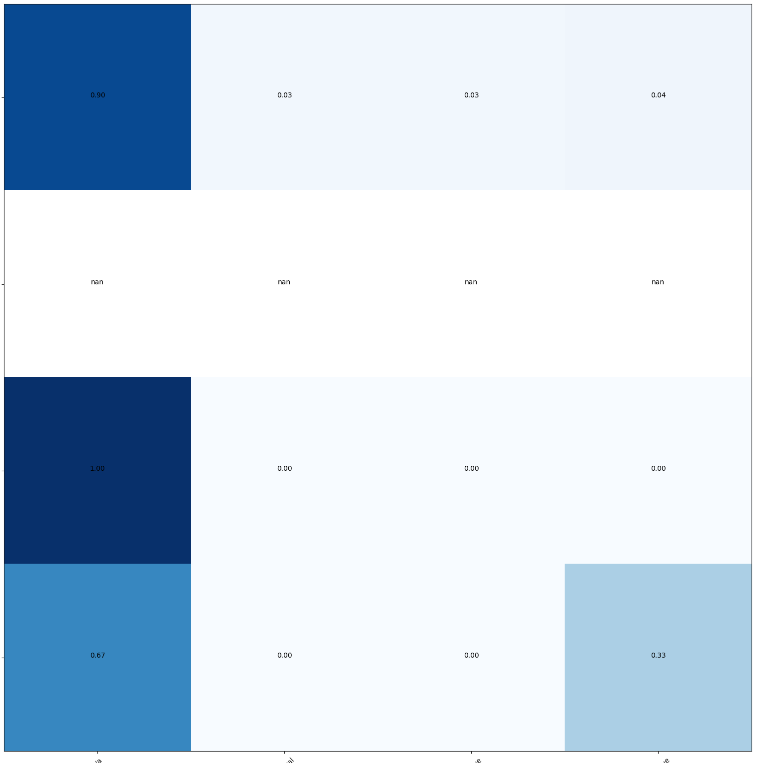
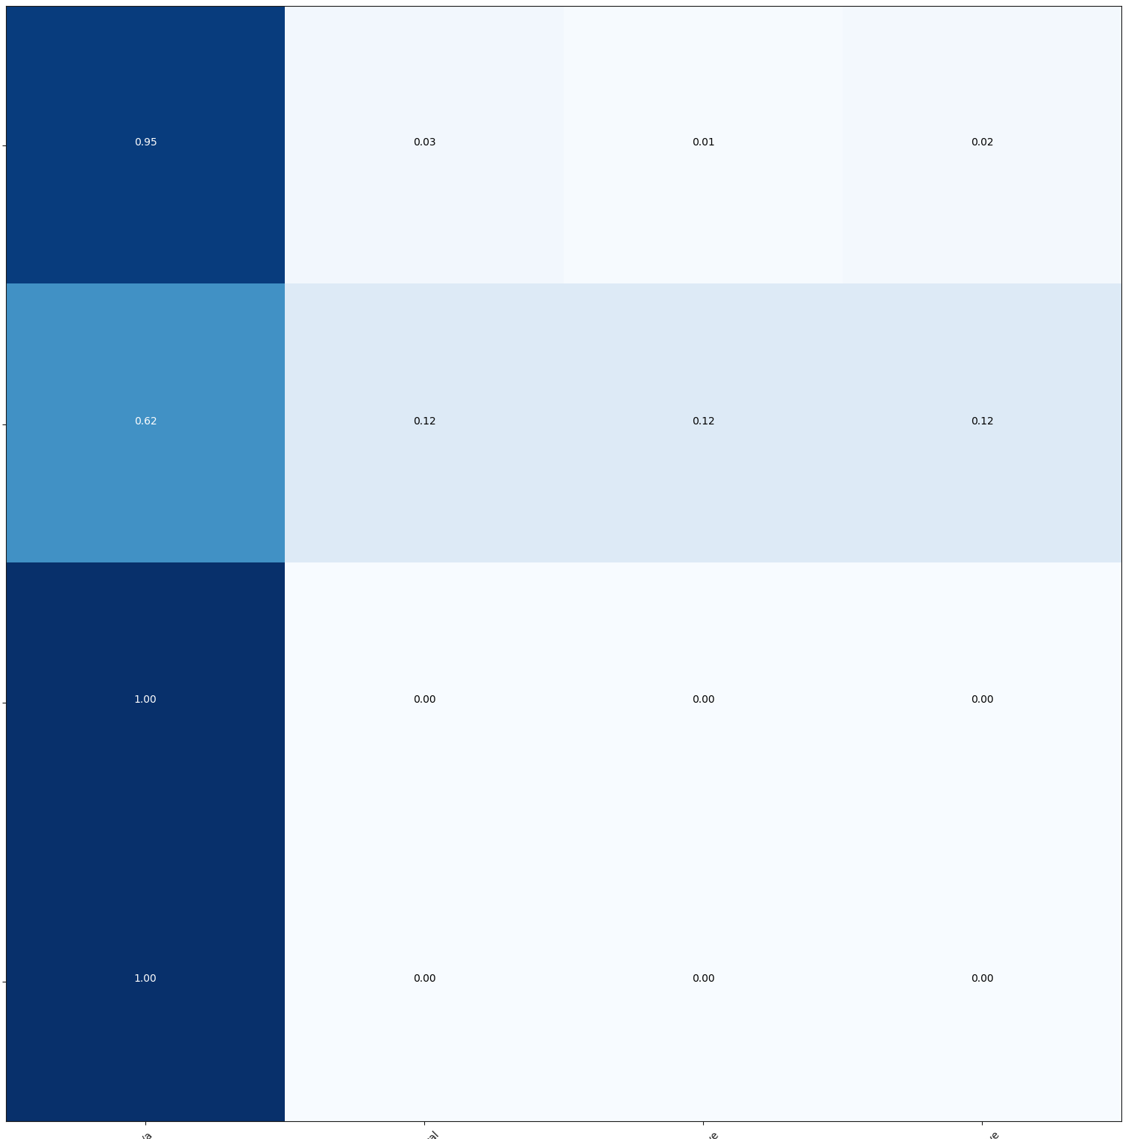
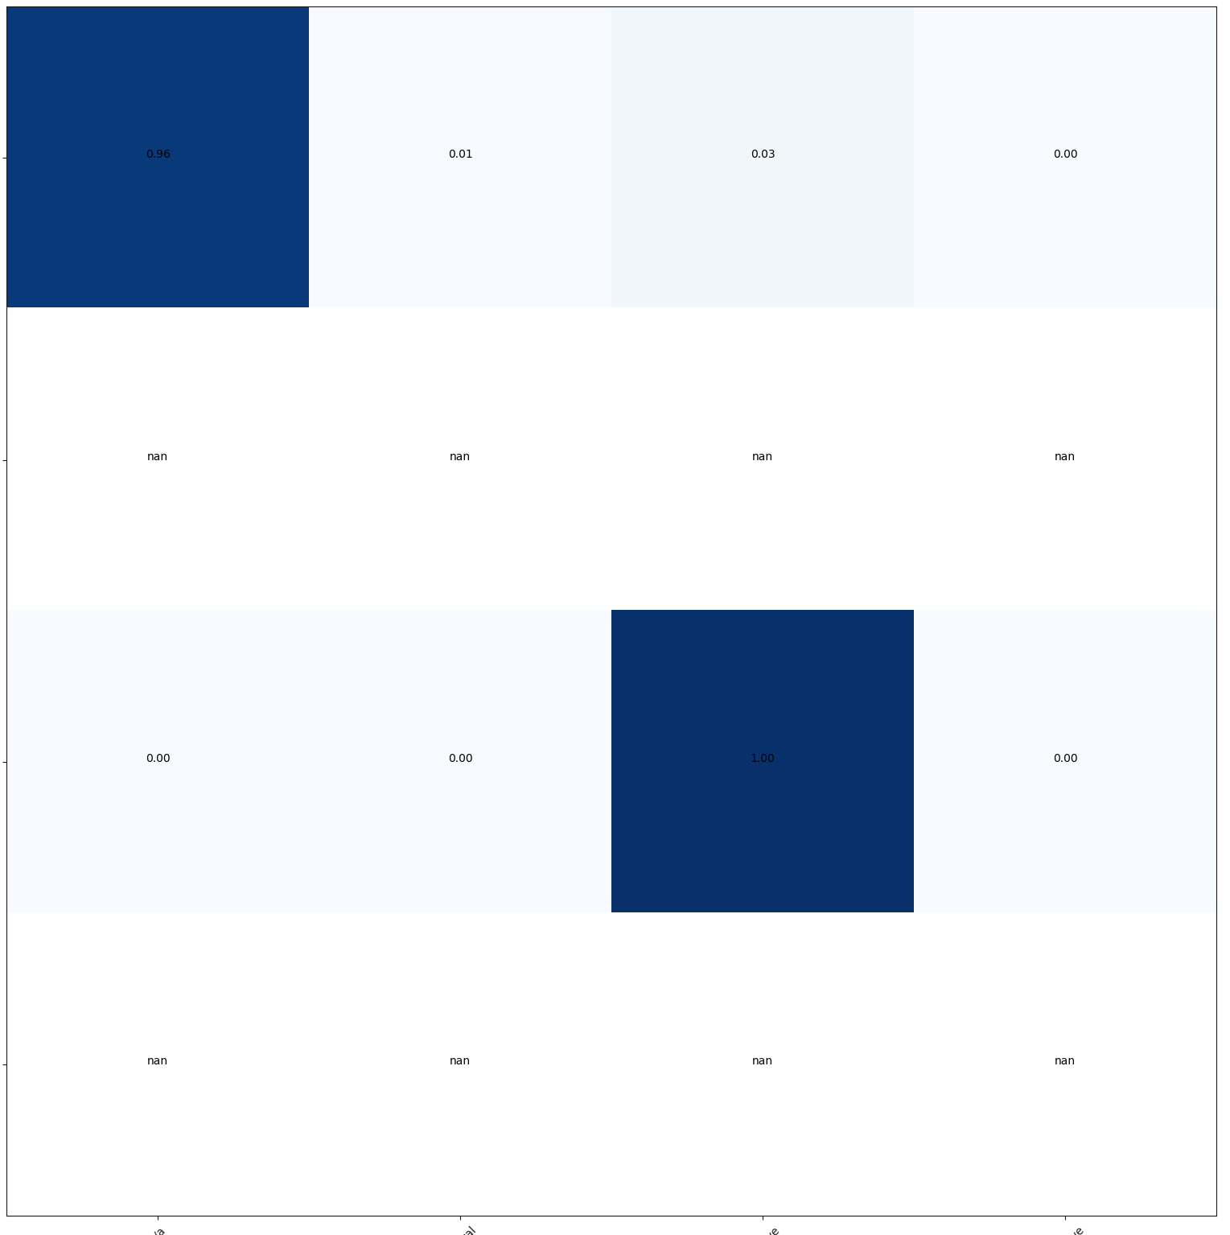
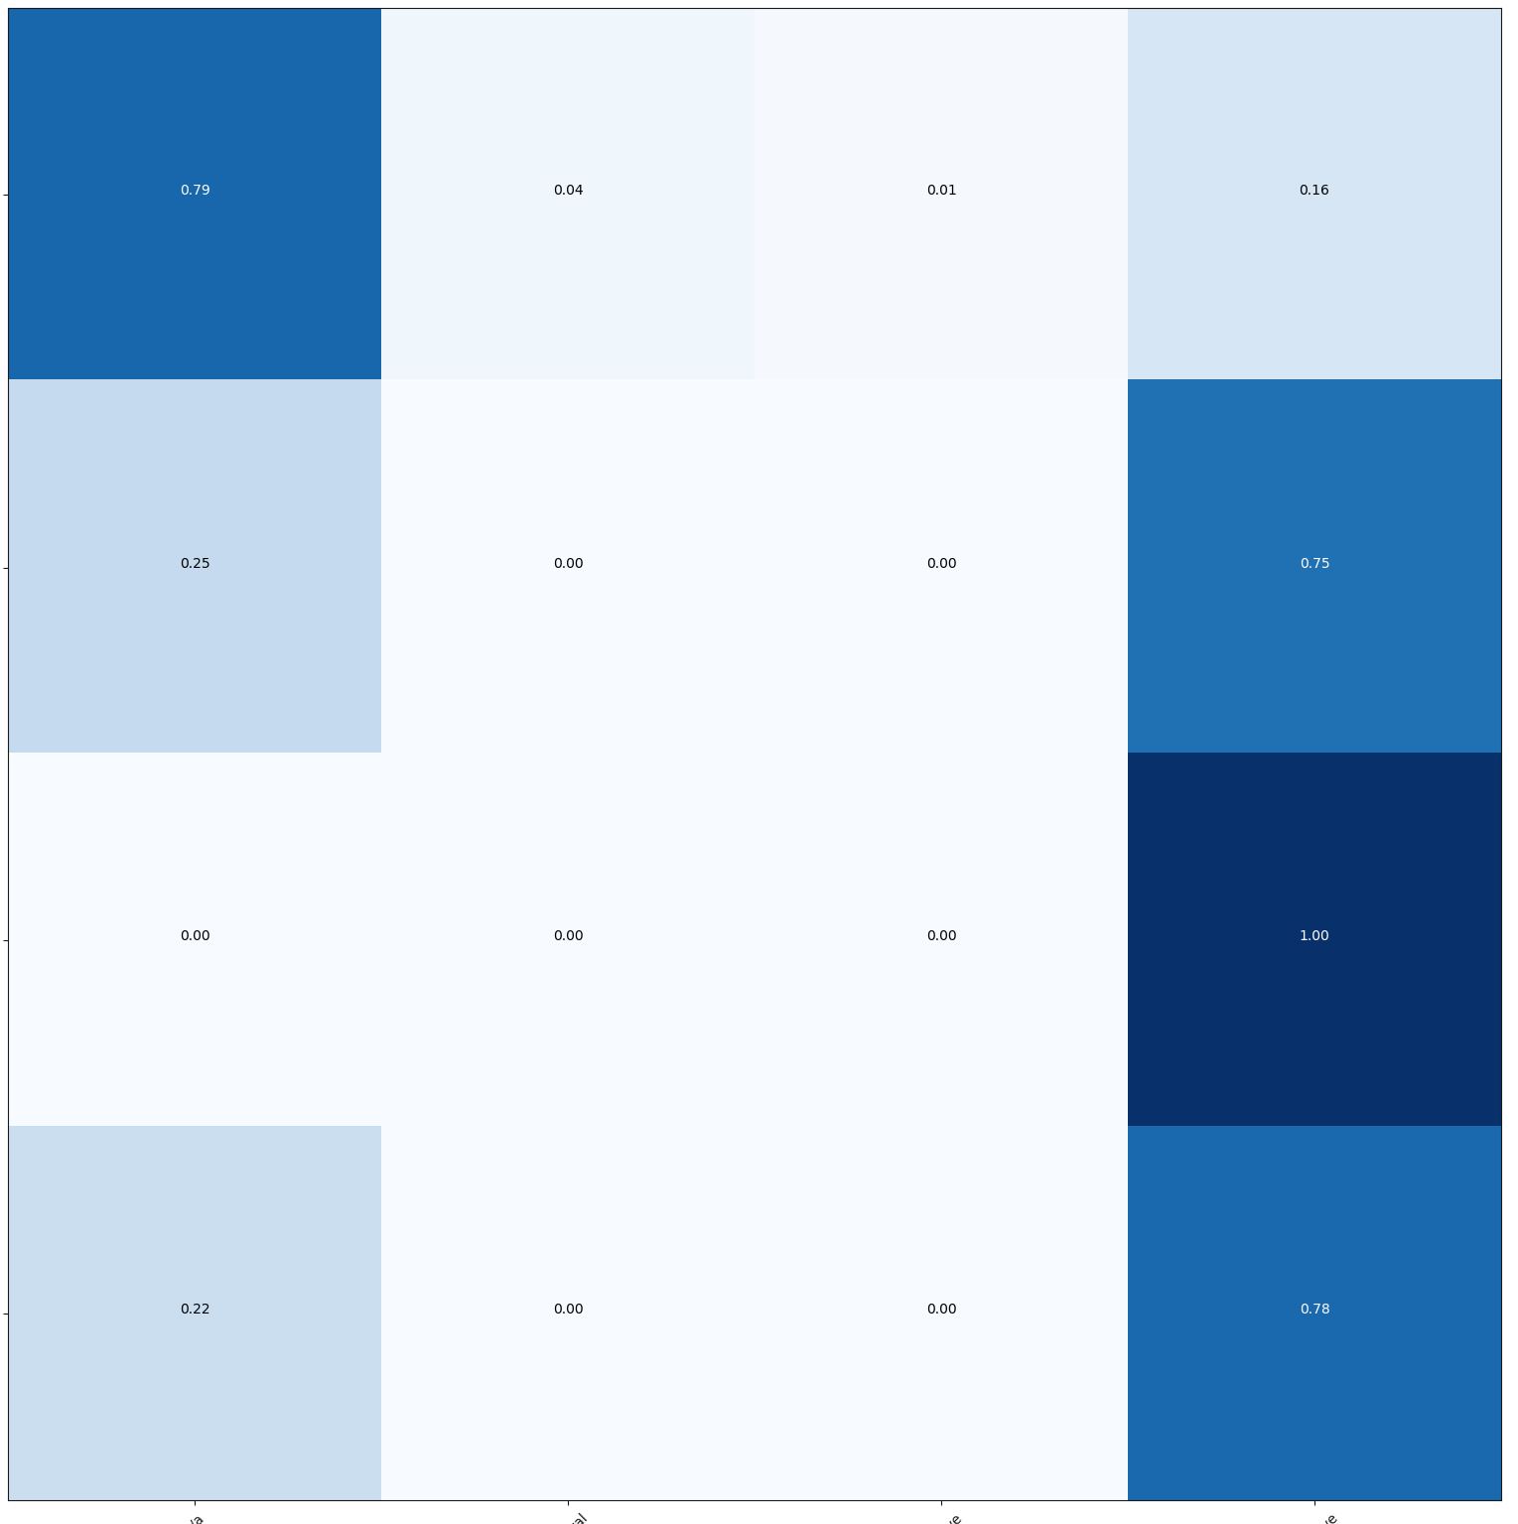
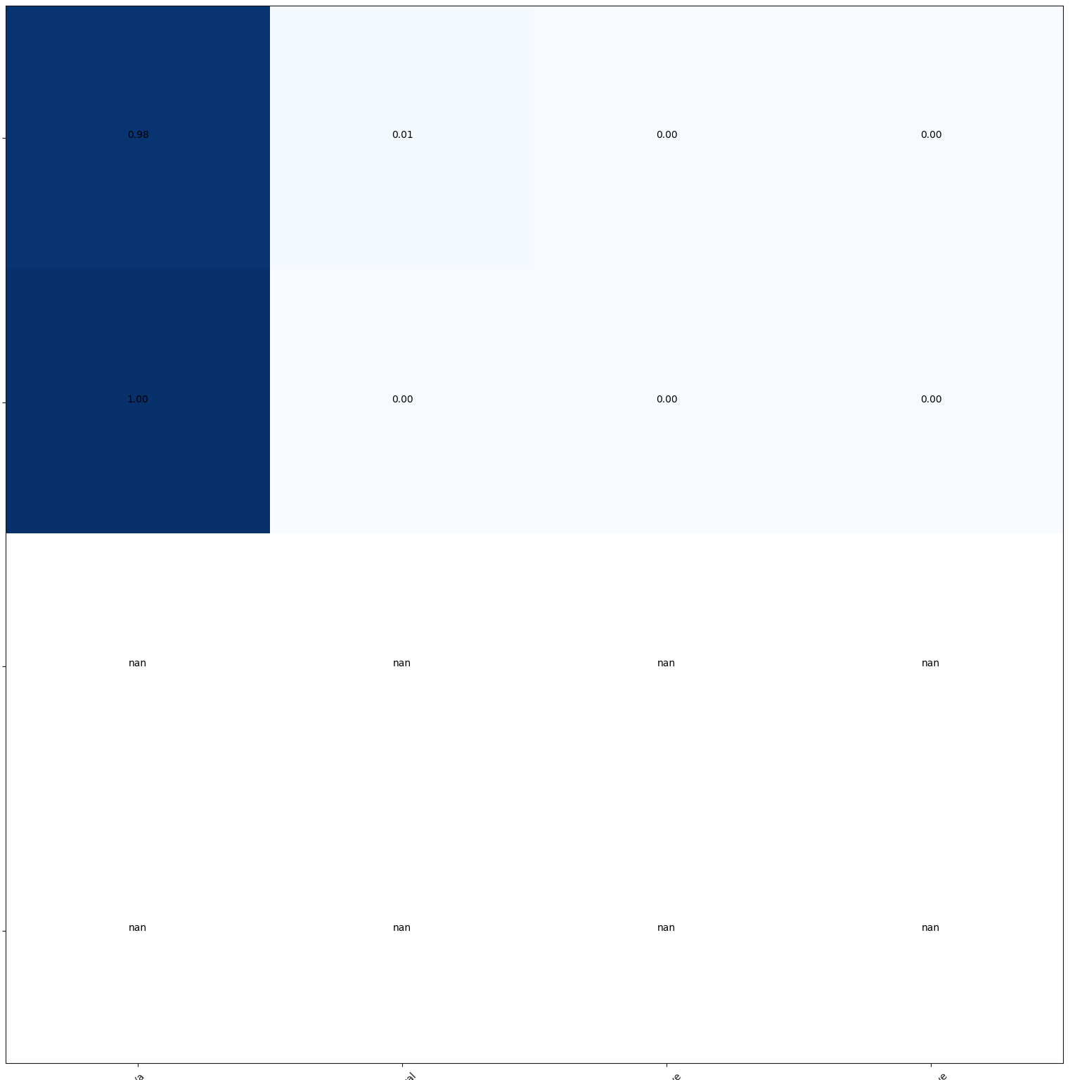
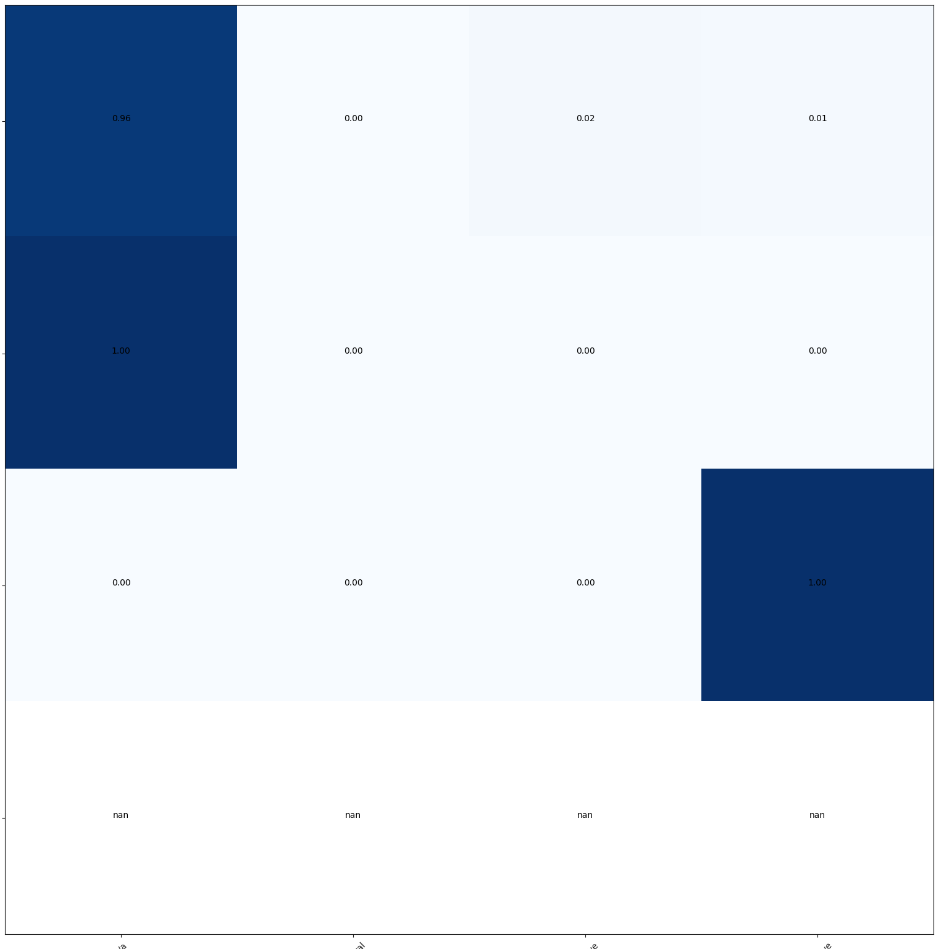

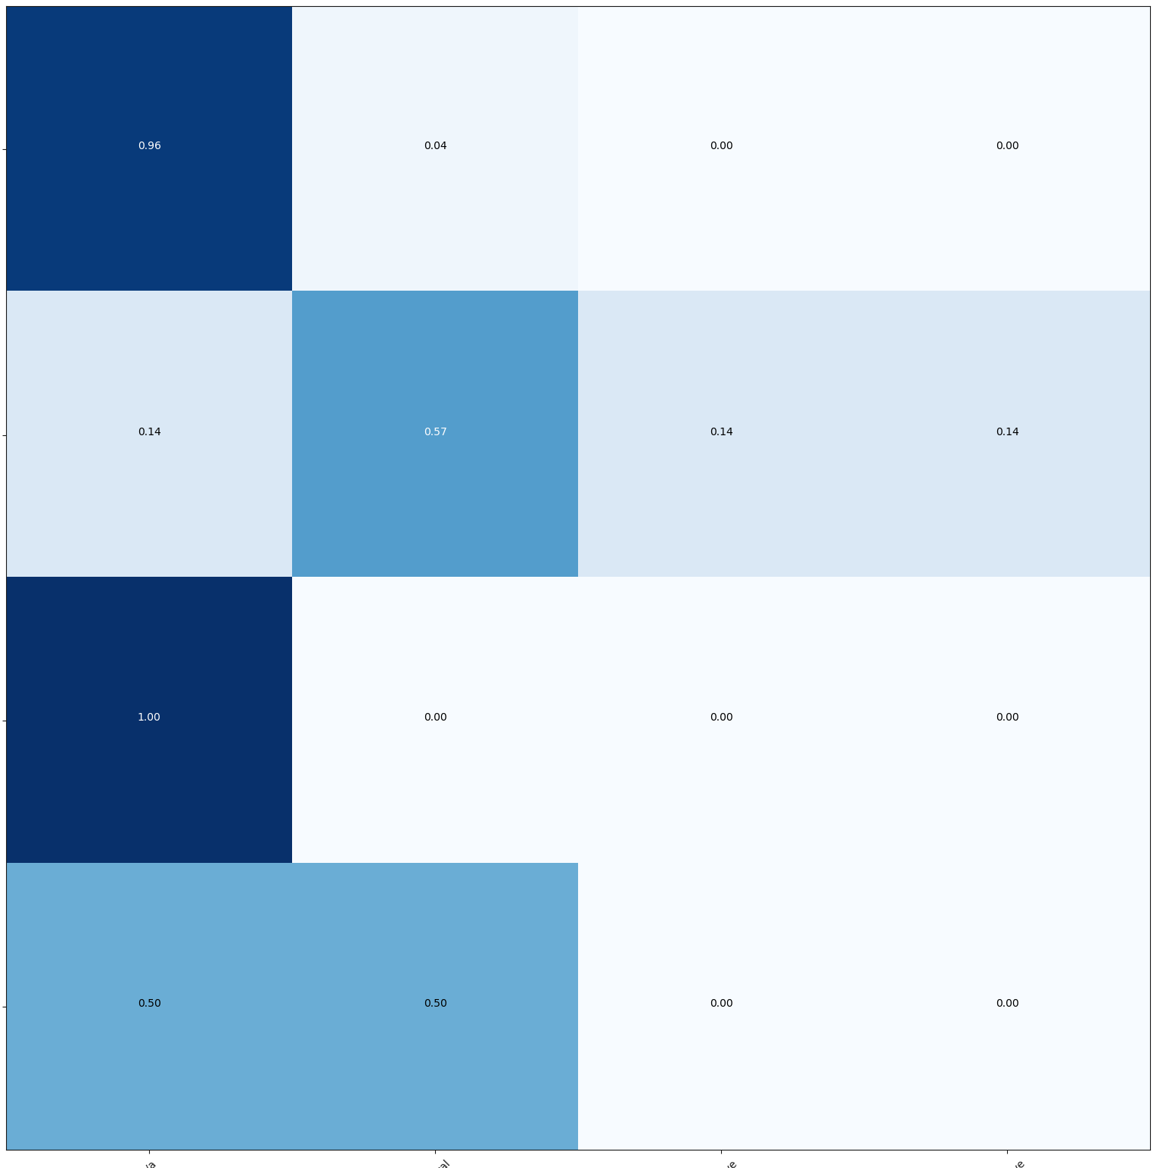
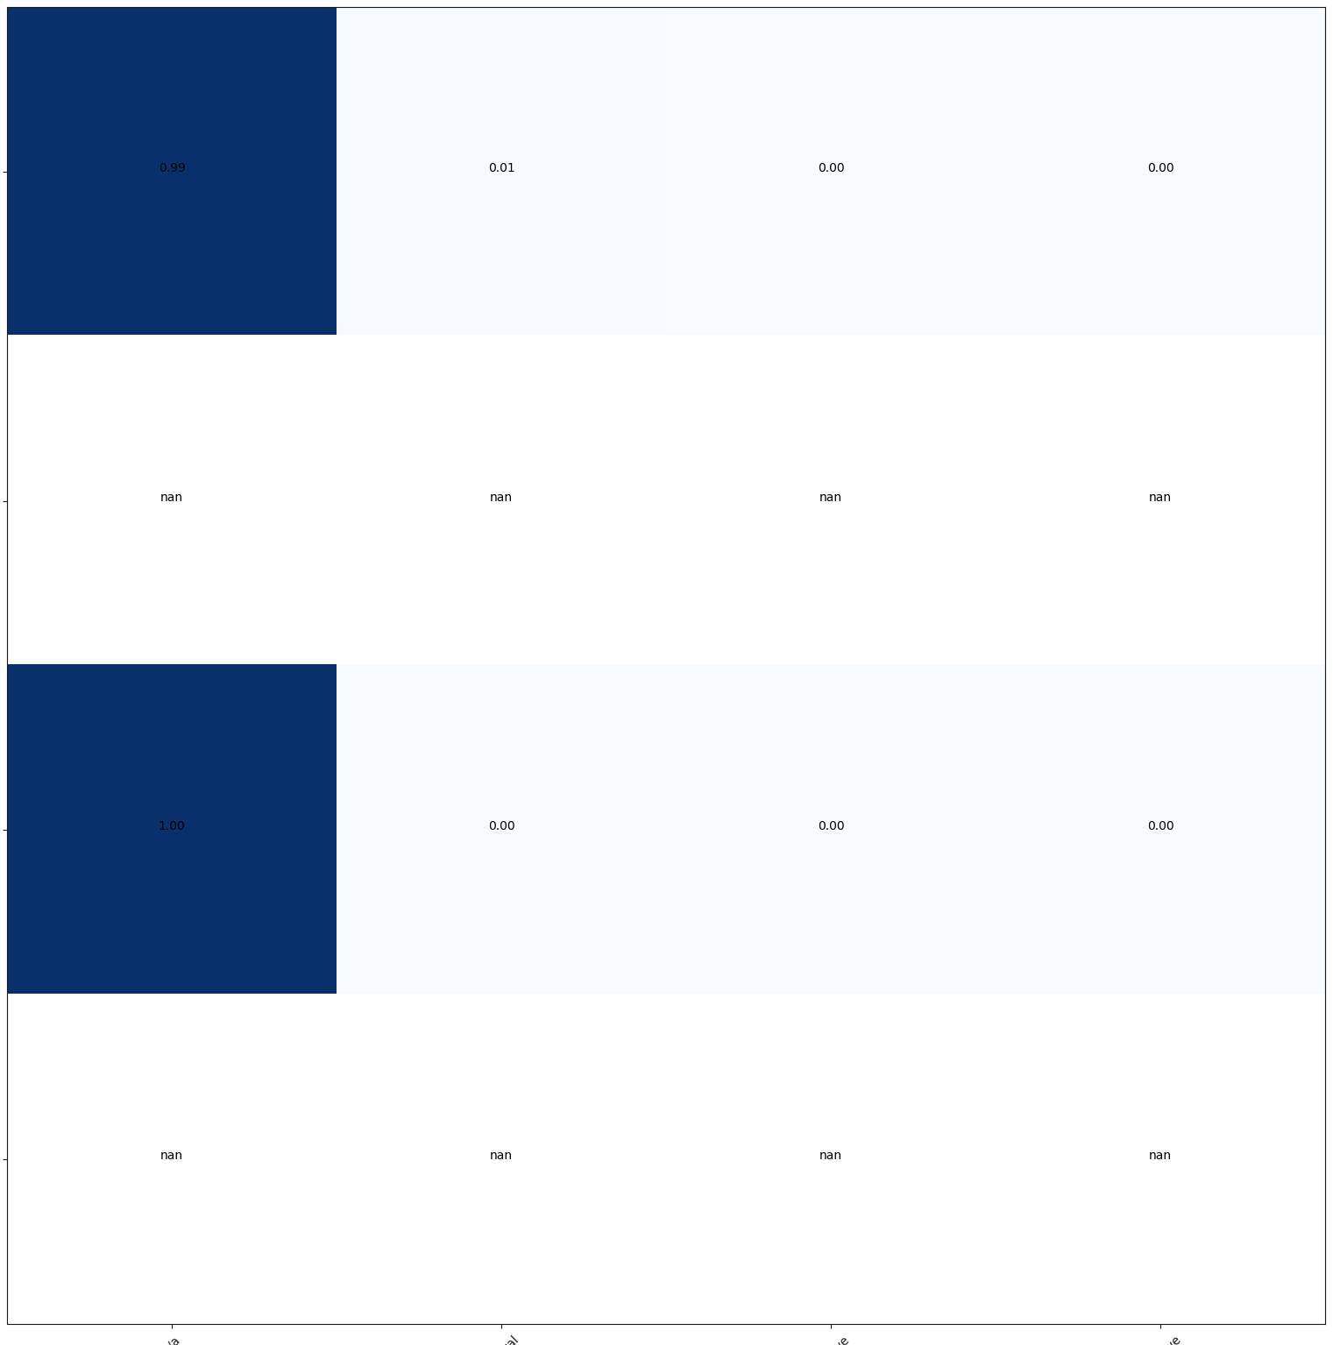
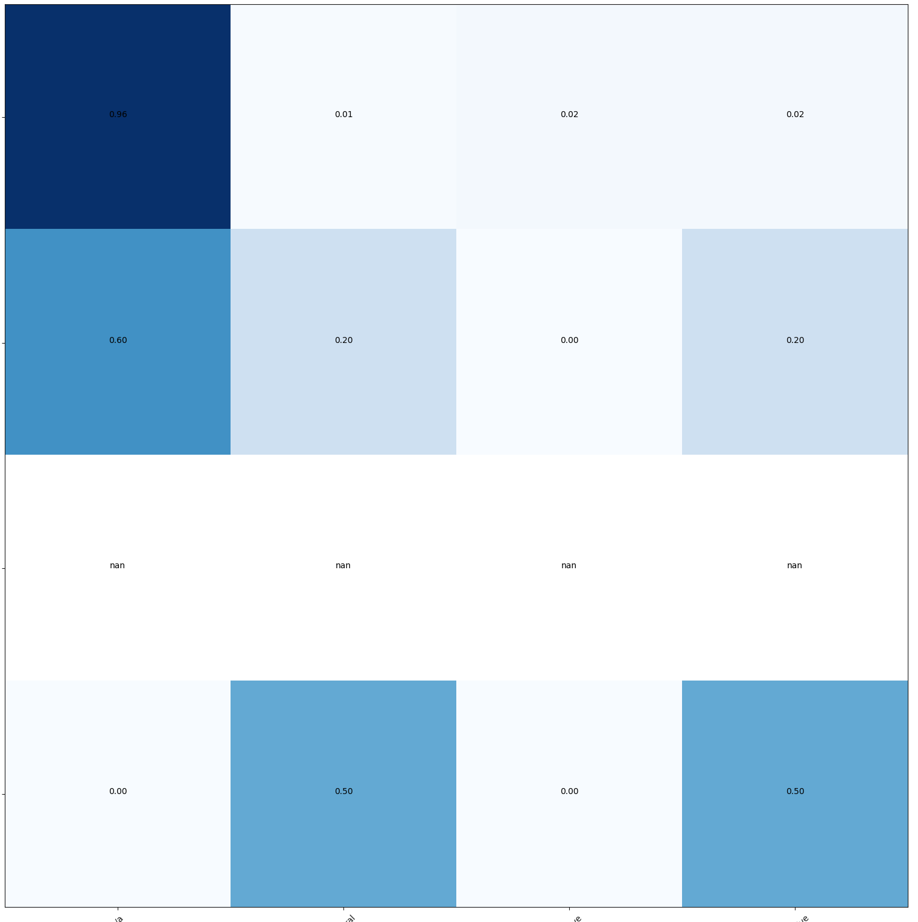

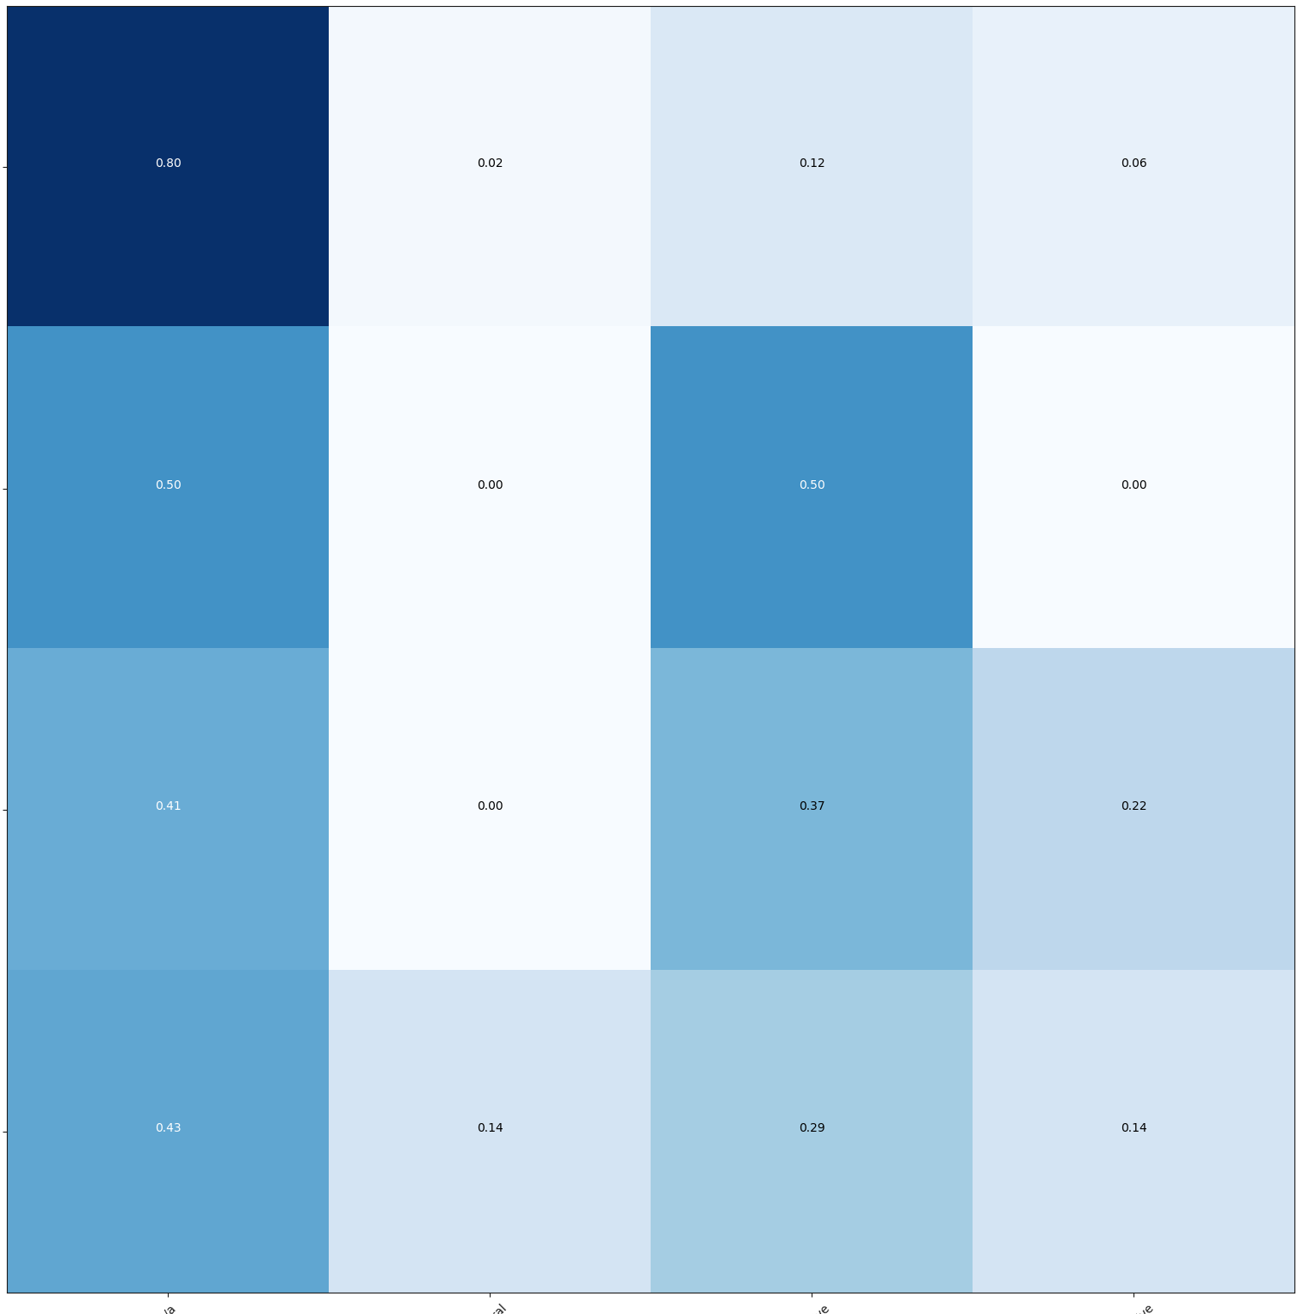
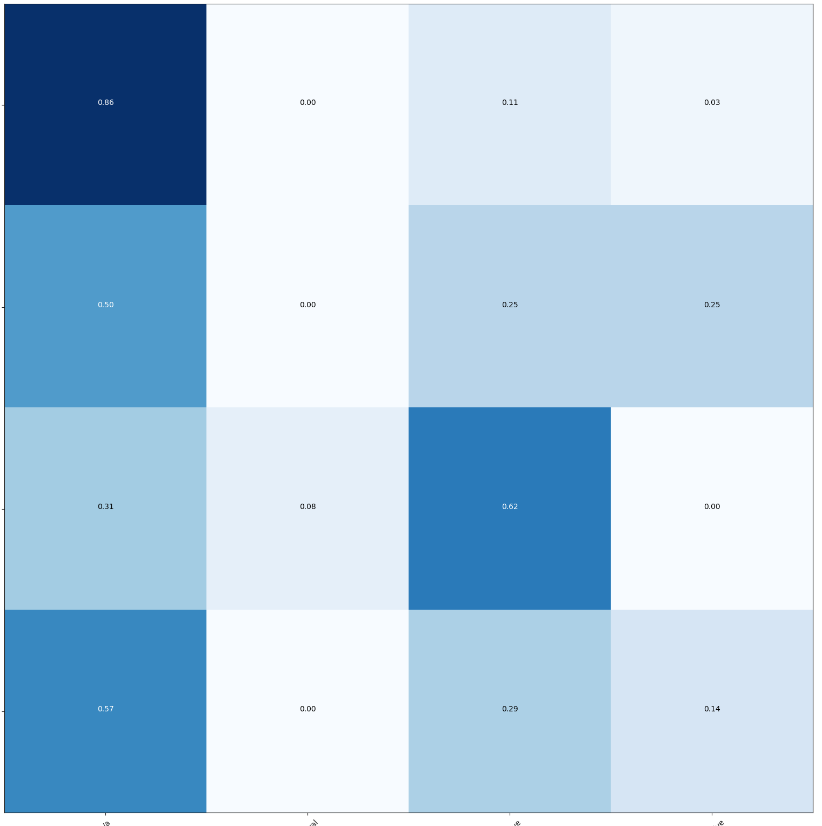
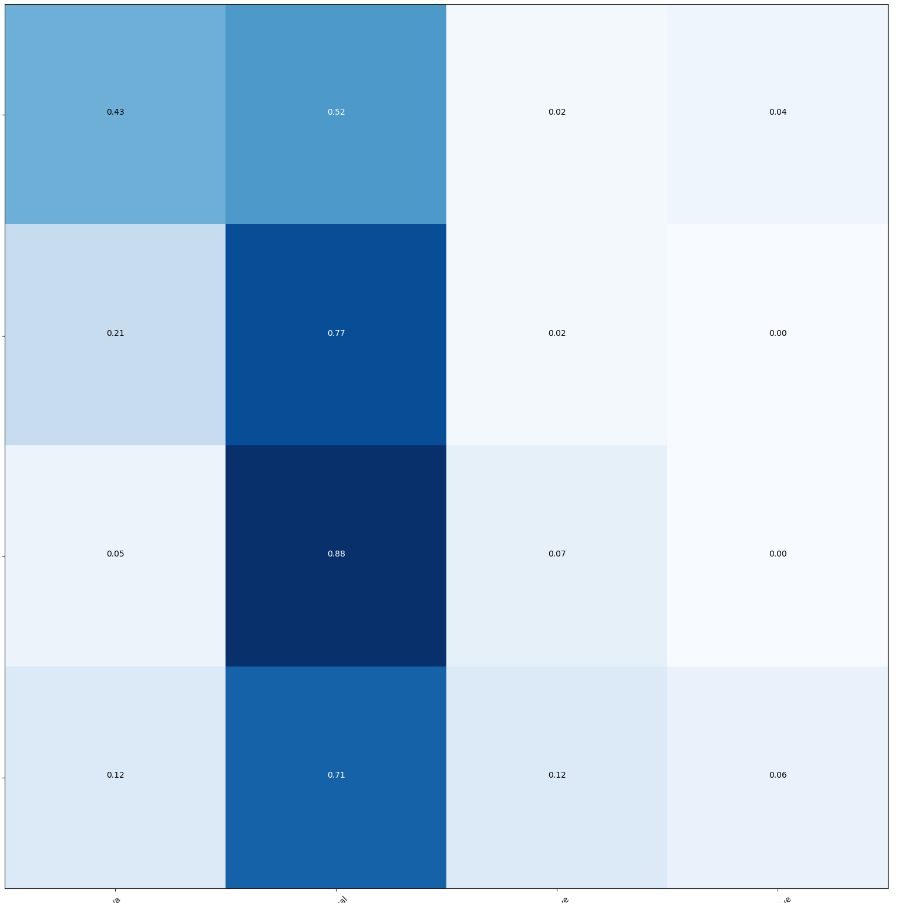
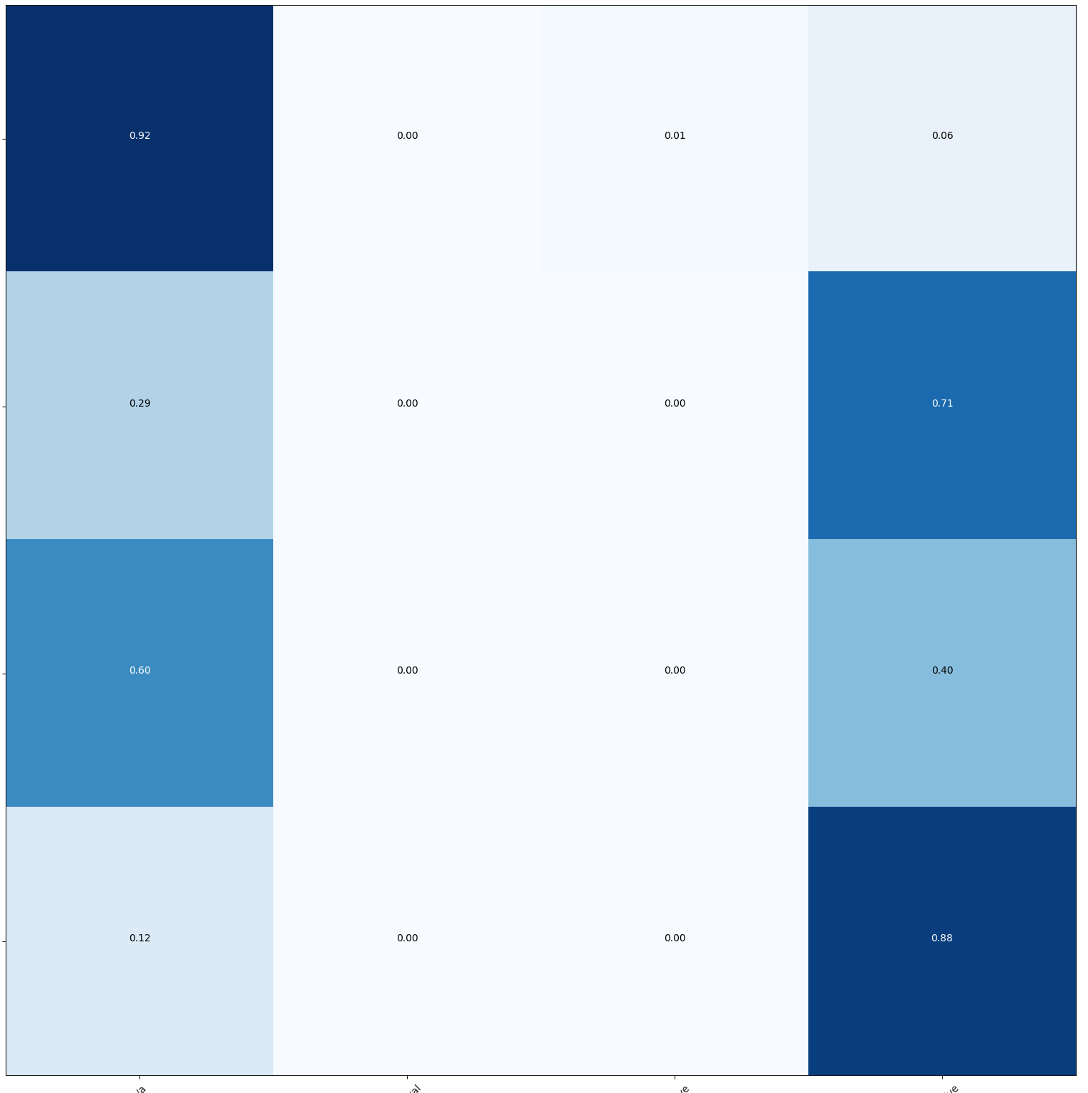
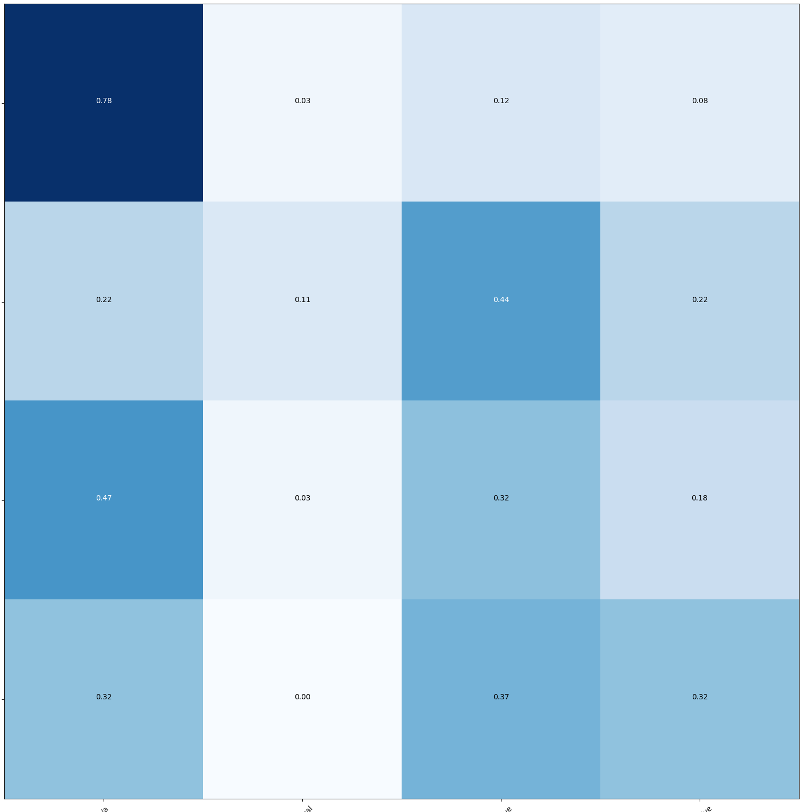
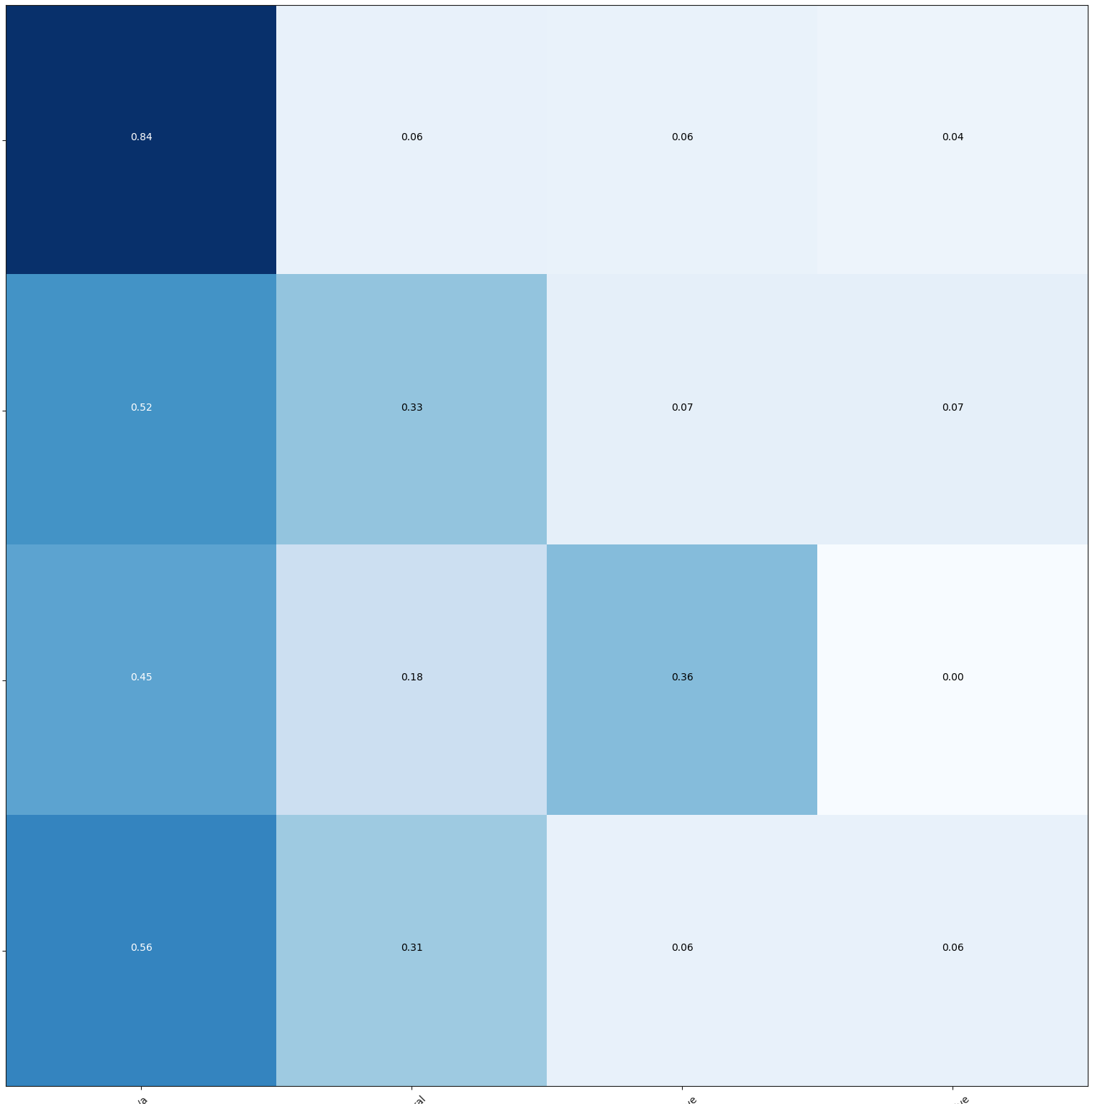
Organic-Coarse - Results
18

Slide 33
Agenda
Introduction: ABSA & Transformer
Useful Information: Docker & Hyperparameters
Discussion of Results
Multitask & Transfer Learning
Conclusion

Slide 34
Multitask Learning
ENCODER N_{x}
ASPECT HEAD #2
ASPECT HEAD #3
ASPECT HEAD #3
SOFTMAX
SOFTMAX
SOFTMAX
| N/A | POS | NEU | NEG |
1 0 0 0
| N/A | POS | NEU | NEG |
0 1 0 0
| N/A | POS | NEU | NEG |
1 0 0 0
HEALTHINESS
QUALITY
PRICE
EMBEDDING
20
INPUTS

Slide 35

Multitask Learning
ENCODER N_{x}
ASPECT HEAD #1
ASPECT HEAD #2
ASPECT HEAD #3
AUX HEAD
SOFTMAX
SOFTMAX
SOFTMAX
SOFTMAX
| N/A | POS | NEU | NEG |
1 0 0 0
| N/A | POS | NEU | NEG |
0 1 0 0
| N/A | POS | NEU | NEG |
1 0 0 0
POS | NEU | NEG |
0 1 0
HEALTHINESS
QUALITY
PRICE
GEN. SENTIMENT
Acts as Regularization – accept model that explains more than one hypothesis
[7]
Increases gradient flow through transformer base in every iteration
EMBEDDING
20
INPUTS

Slide 36
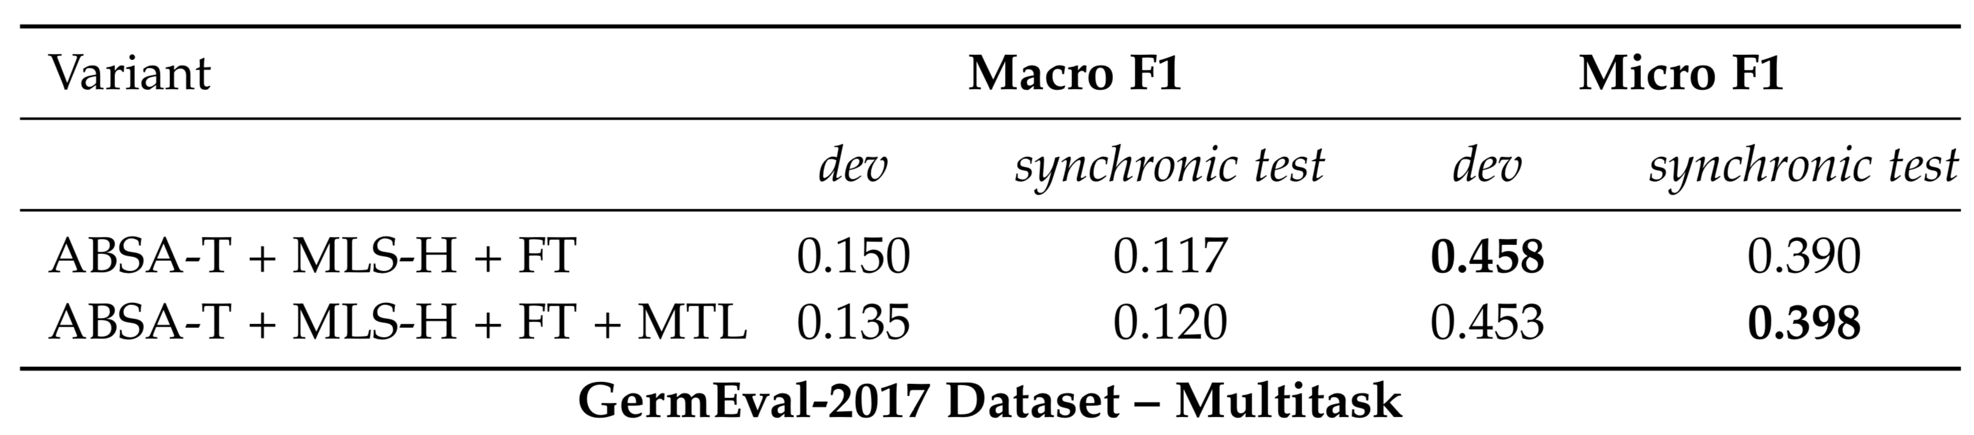
Multitask Learning – Results
GermEval-2017
Schmitt et al.
Dugar
ABSA-T
21

Slide 37


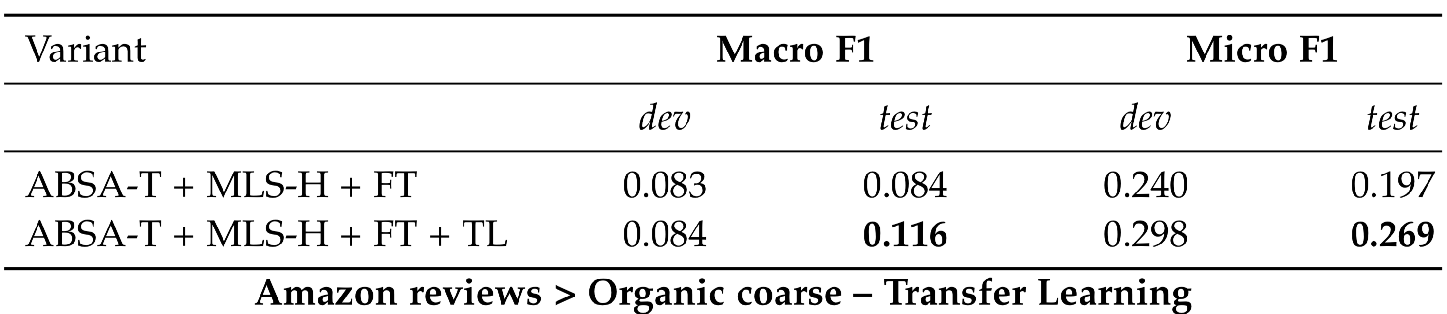
Transfer Learning – Results
~ 1.2 Million reviews
Category Based Sentiment Anaylsis
20 categories
Balanced along category and sentiment
22

Slide 38
Transfer Learning – Results
~ 1.2 Million reviews
Category Based Sentiment Anaylsis
20 categories
Balanced along category and sentiment
22

Slide 39
Agenda
Introduction: ABSA & Transformer
Useful Information: Docker & Hyperparameters
Discussion of Results
Multitask & Transfer Learning
Conclusion

Slide 40
Conclusion
The Transformer model can classify Aspect Based Sentiment without recurrence or convolutions.
It is competitive with State-of-the-art methods and outperforms other pipeline or LSTM methods.
Multitask Learning with auxiliary supervised tasks is able to improve a model.
Transfer Learning can boost model performance of the Transformer Base.

Slide 41
Thank you

Slide 45
Organic Coarse

Slide 51
References
[1] https://www.amazon.co.uk/gp/customer-reviews/REII5J393XCJW/ref=cm_cr_dp_d_rvw_ttl?ie=UTF8&ASIN=B007LJ4PPO
[2] A. Vaswani, N. Shazeer, N. Parmar, J. Uszkoreit, L. Jones, A. N. Gomez, L. Kaiser, and I. Polosukhin. “Attention Is All You Need.” In: (2017). issn: 0140-525X. doi: 10.1017/S0140525X16001837. arXiv: 1706.03762.
[3] http://jalammar.github.io/illustrated-transformer/
[69] M. Schmitt, S. Steinheber, K. Schreiber, and B. Roth. “Joint Aspect and Polarity Classification for Aspect-based Sentiment Analysis with End-to-End Neural Networks.” In: (Aug. 2018). arXiv: 1808.09238.
[84] M. Wojatzki, E. Ruppert, S. Holschneider, T. Zesch, C. Biemann, and A. CogSci. “GermEval 2017: Shared Task on Aspect-based Sentiment in Social Media Cus- tomer Feedback.” In: Proceedings of the GSCL GermEval Shared Task on Aspect-based
[18] S. Dugar. “Aspect-Based Sentiment Analysis Using Deep Neural Networks and Transfer Learning.” Master’s Thesis in Informatics. TECHNISCHE UNIVERSITÄT MÜNCHEN, 2019.
[6] S. Ruder. “An Overview of Multi-Task Learning in Deep Neural Networks.” June 2017 arXiv: 1706.05098.

Slide 52
References
All Icons from FlatIcon http://flaticon.com
Title Image: Paramount Pictures

